Slide 1
Saman Guru Service Guru !
Group 5
Niko Gurung
Neha K.C.
Nischal Shrestha

Slide 2
Introduction
Internet usage is increasing day by day. For small information people prefer the internet as the internet has become cheaper compared to previous times and it is a less time-consuming process. During this pandemic, the value for the internet has increased more. Nowadays, the online buying trend too has increased a lot in Nepal. People prefer to check for the
products online may be the price, quality, or any details
before actually purchasing it.

Slide 3
Who we are?
SamanGuru.com.np is an integrated and complete chain website and mobile application which comes with an impressive set of tools required to market the products for the distributors, multiple choices for selecting merchants for wholesalers and relatively cheap priced products for consumers, and makes online sales fast and efficient. Interest in buying products online is increasing. And the closer a shopper gets to the buyer, the greater the attraction to the online channel.
SamanGuru.com.np will be a web-based application and mobile application which aims to become the market leader in offering online merchants and consumers a uniform and trouble free way to return merchandise purchased online (Return Policy) and to enhance customer service of online merchants, boost their customer retention and increase their
sales using our platform.

Slide 4
Company Ownership
Board of Members
Niko Gurung: Developer and IT Consultant
Neha K.C. : Quality Assurance Engineer
Nischal Shrestha : Marketing Head

Slide 5
Value Proposition
Distributor: Hassles less work because digitally they will get wholesalers who buy their product and digitally finance, sales, everything will be managed.
Wholesaler: Multiple choice for selecting vendors and from same platform they can sell to Consumer
Consumer: No retailer in the middle so consumers will get products cheaper and our main priority is to provide after sales service to customers (Return Policy).

Slide 6
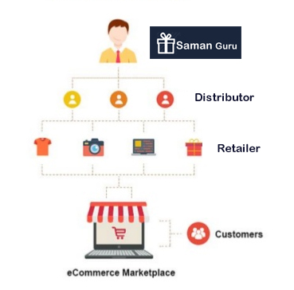
Work Flow

Slide 7
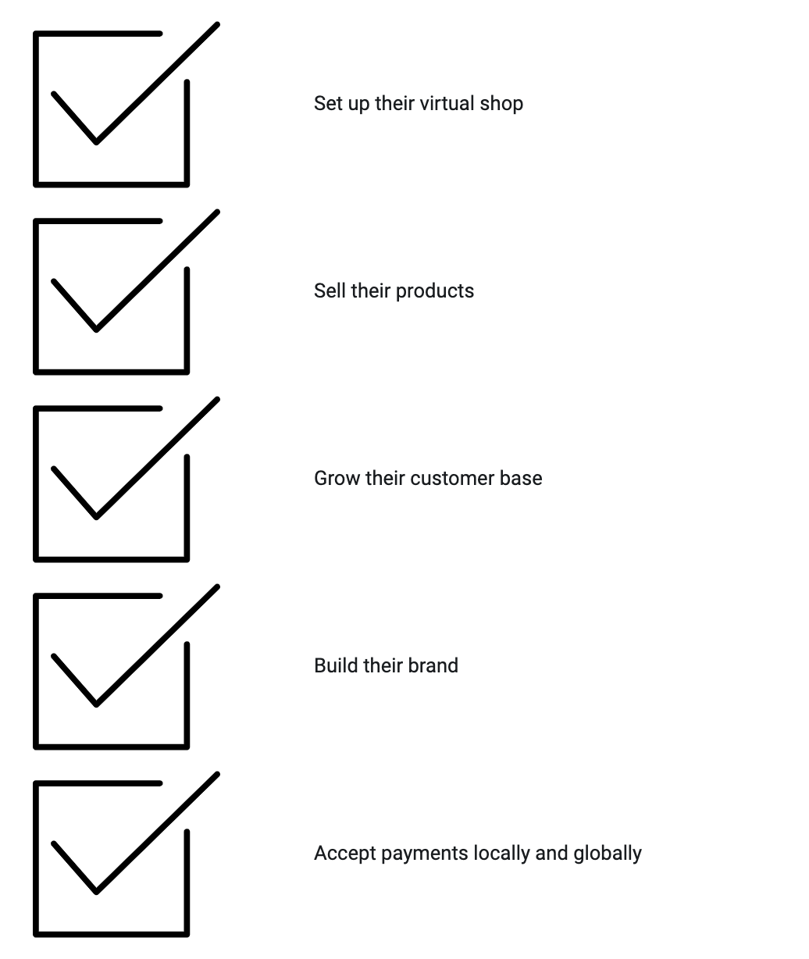
Detailed Work Flow

Slide 8
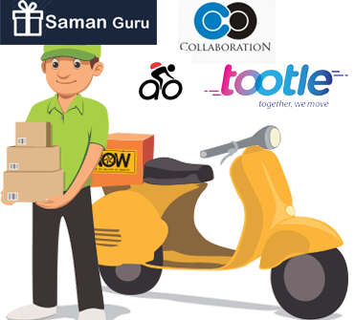
Logistic

Slide 9
Our Product / Service
B2B Dashboard (Distributor and Wholesaler)
User Dashboard(Customer)
Uploading Photos and Information
Online Products Details
User Profile
Comment
Search Option
Recommendation System
Nearby Shop Feature
Mobile Application (iOS & Android)
Customer Service Platform (Claims/ Return Policies)

Slide 10
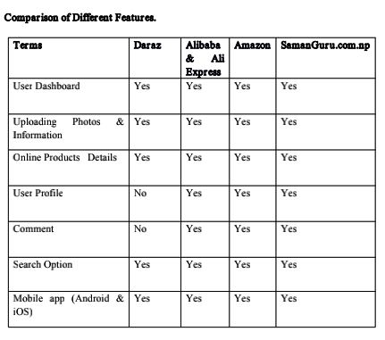
Market Analysis Summary

Slide 11
Revenue Model
Sales Commission
Advertisement
Google Adsense
Quick Sales (Top Rated, Most Viewed ) Paid Section
1
4
Logistic (Online Delivery)
Subscription
2
5
3
6

Slide 12
Marketing Strategy
Content Marketing
Offer Gift Guide
Referral Marketing
Email Marketing
1
4
Social Media Marketing / Digital Marketing
Search Engine Optimization
2
5
3
6

Slide 13
SWOT Analysis
Strength
Weakness
2
1
Threats
Opportunity
3
4

Slide 14
SWOT Analysis
Strength
•Engages Consumers with “Instant Buy” and "Quick return policy” capabilities
•Creates a strong link between manufacturing, distributor and wholesaler & retailer
•Enables pricing, availability etc. to responding directly and instantly to market pressure
•Reduces the cost of rolling out new products
•Increases customer engagements
•Creates strong drive add-on sales
1

Slide 15
SWOT Analysis
Weakness
•Entering the online market requires to be competitive and have the highest level of customer’s service in place
•Reviews and negative comments can spread quickly and damage customer brand and staying on top of Cost of entry can be high
•Online market makes it easy for customers to comparison shop for B2B and B2C
•Real-time nature requires constant attention
•Web change (new browser, technologies, capabilities, competitive advantages etc.) require web development to be ongoing not one time expenses
2

Slide 16
SWOT Analysis
Opportunities
•New customer information can be used to identify and exploit new markets
•Responsive marketing and sales can drive new sales opportunities
•Integration with back end system can improve transaction turn around
and increase productivity
•Automated processing and systems can keep customer well informed
•For logistic purpose, ride sharing companies can be our logistic partner
3

Slide 17
SWOT Analysis
Threats
•Being 2nd or later to market requires significant difference or improvement from existing sites to overcome first-to market
•Learning web technologies and how to leverage them can be difficult and not knowing them can be disastrous
•Big Players can be almost impossible to complete with (Even by other Big players)- we are unlikely to be the next e-bay, the next amazon
•Copy and renew is a normal development strategy
•Backend system must be able to handle the front end and be integrated (Technology threat)
4

Slide 18
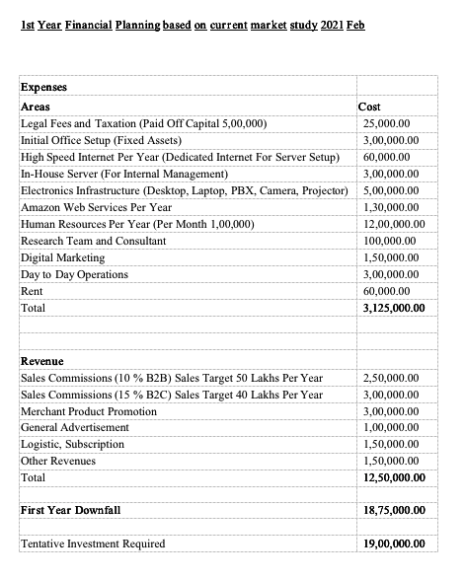
Finance Plan

Slide 19
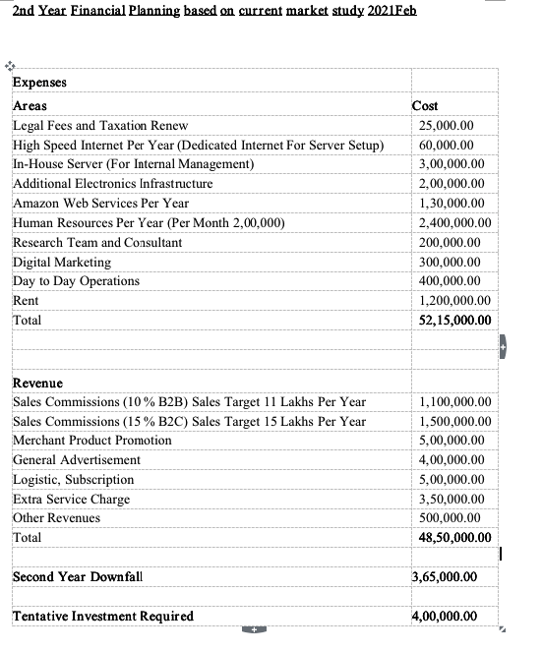
Finance Plan

Slide 20
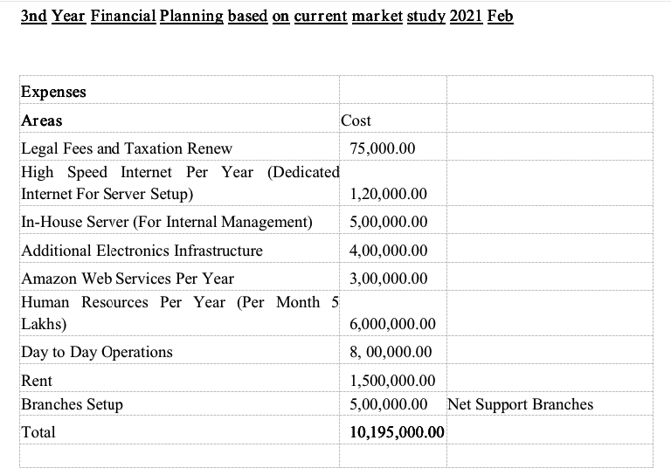
Finance Plan

Slide 21
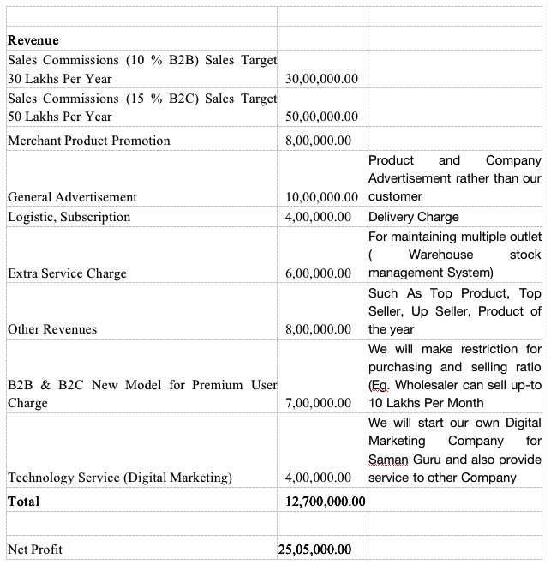
Finance Plan

Slide 22
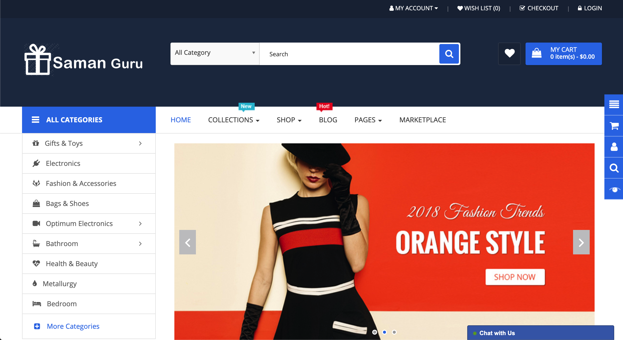
Prototype
Prototype

Slide 23


